Slide 1
Introduction to Convolutional Neural Networks
Developed by Titus Tang 2020

Slide 2
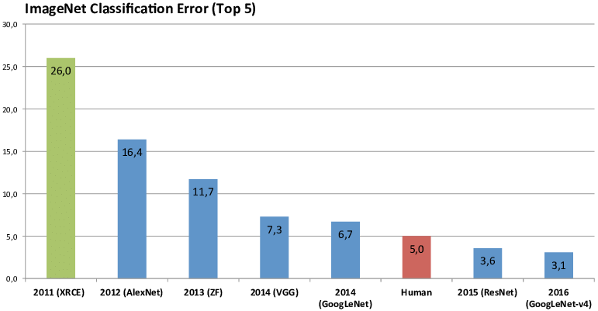
Beating humans since 2015
ImageNet Large Scale Visual Recognition Challenge (ILSVRC)
Object localisation on 1000 categories.
Test and validation set of 150,000 images.

Slide 3
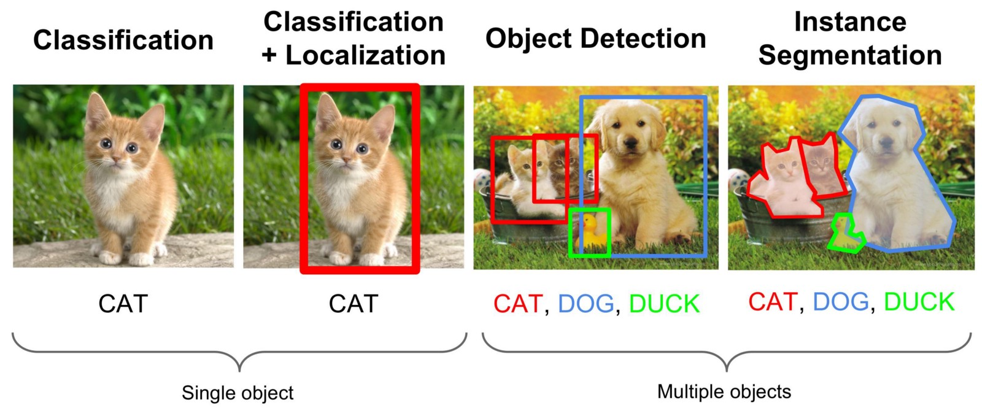
Computer Vision Tasks
Pixel values
?
Output
How do you process visual information at the pixel level?

Slide 4
Can we use a Multilayer Perceptron?
Each perceptron in layer N will have #Perceptrons(Layer(N-1))+1 weights.
1000x1000 pixel image = 1M weights per perceptron.
If 1 perceptron per pixel, there will be ~1,000,000,000,000 weights in each of N layers. Intractable!
N11
W11
W12
N21
W21
...
N12
...
W22
N22
W31
N13
W32

Slide 5
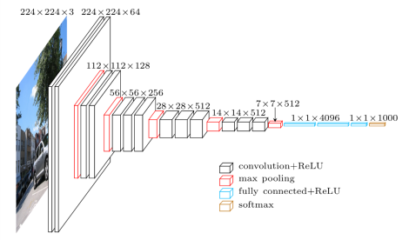
Overview of a Convolutional Neural Net for Classification
The aim is to choose layers that go from a large input image to a specific desired output format.
Repeated stacking of layers in a specific order.

Slide 6
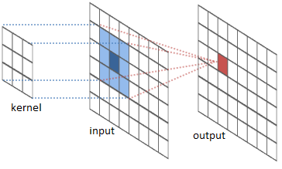

Convolutions
The kernel represents the pattern to be detected.
The more the input matches the kernel, the more positive the output response would be.
Convolutions are pattern detectors.

Slide 7
Convolution Example
Input patch
Kernel
Output
10 | 6 | 6
0 | 10 | 6
0 | 0 | 10
1 | 0.5 | 0.5
-1 | 1 | 0.5
-1 | -1 | 1
*
=
39
Good match
6 | 6 | 10
6 | 10 | 0
10 | 0 | 0
1 | 0.5 | 0.5
-1 | 1 | 0.5
-1 | -1 | 1
*
=
8
Poor match
0 | 0 | 0
6 | 6 | 6
10 | 10 | 10
1 | 0.5 | 0.5
-1 | 1 | 0.5
-1 | -1 | 1
*
=
-7
Poor match

Slide 8
Pooling
Slide a window across the input and pick a value at every window position.
Max pooling – take the max value.
Average pooling – take the average value.
Pooling layers are information filters.
10 | 6 | 6 | 0
5 | -3 | 14 | -2
0 | 2 | -7 | -3
0 | 0 | -5 | -5
10 | 14
2 | -3
Max pooling

Slide 9
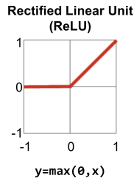
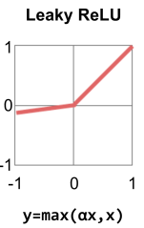
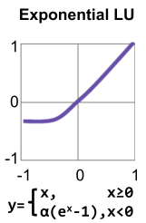
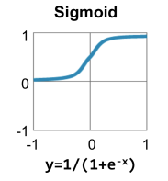
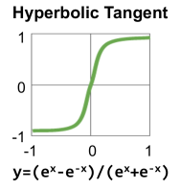
Activation Functions
Introduces nonlinearities to the network.
Allows for the modelling of more complex non-linear functions.
Most popular is the ReLU.

Slide 10
Fully Connected Layers
Nodes in one layer are connected to every node in the next layer.
Used to “see the big picture” of what is happening.
An aggregator of information.

Slide 11

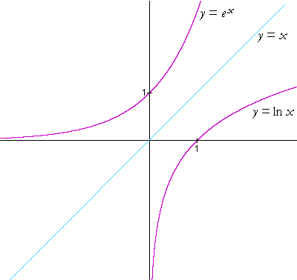
Softmax
Converts all input to a range between 0 and +infinity.
Then normalises all values between 0 and 1.
A convenient way to interpret network output as probabilities.
used because it is easily differentiable.

Slide 12
Building a Convolutional Neural Net
Convolutions to find features, activations to filter good features, pooling to select the best features.
Repeat stacking of layers to find features of features -> high level features.

Slide 13
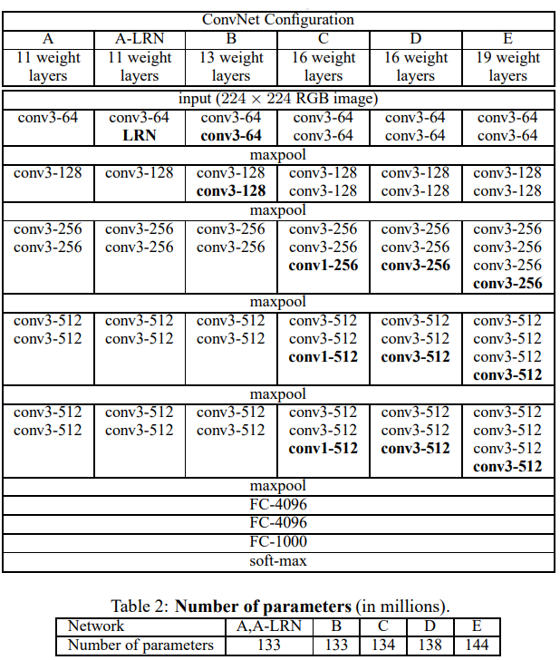
Variants of the VGG network

Slide 14
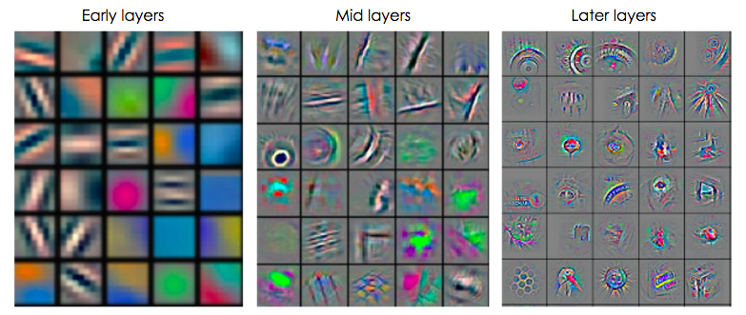
Visualising Layers of a Convolutional Neural Net
Low level features consists of simple geometrical patterns.
The higher you go, the more object-like patterns you can identify.
Low level features
High level features

Slide 15
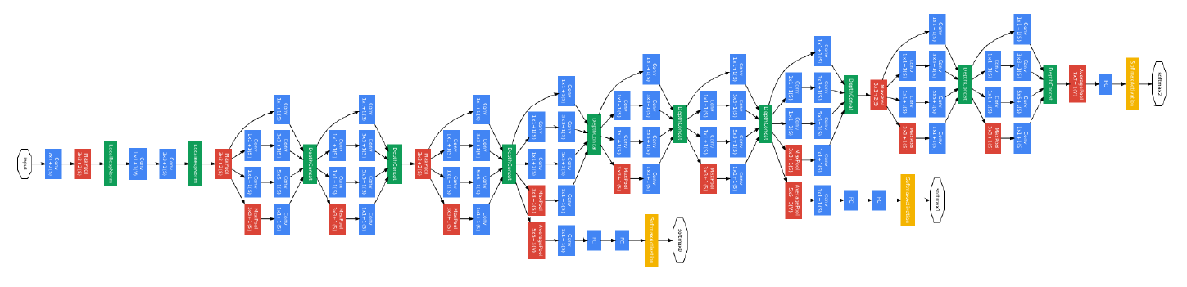
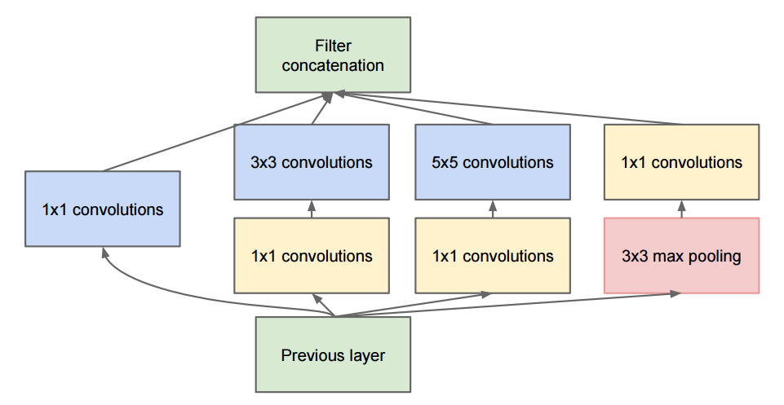
GoogleNet

Slide 16
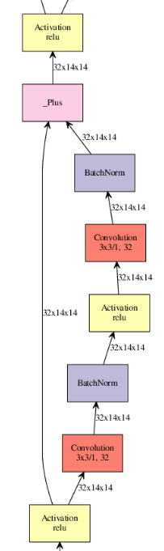
Residual Networks - Resnet
The right branch contains the typical layers of a conv-net.
The left branch allows the backpropagated errors to flow directly through without being diminished through the layers on the right.
Avoids the vanishing gradient problem.
Resnet-56, 2015

Slide 17
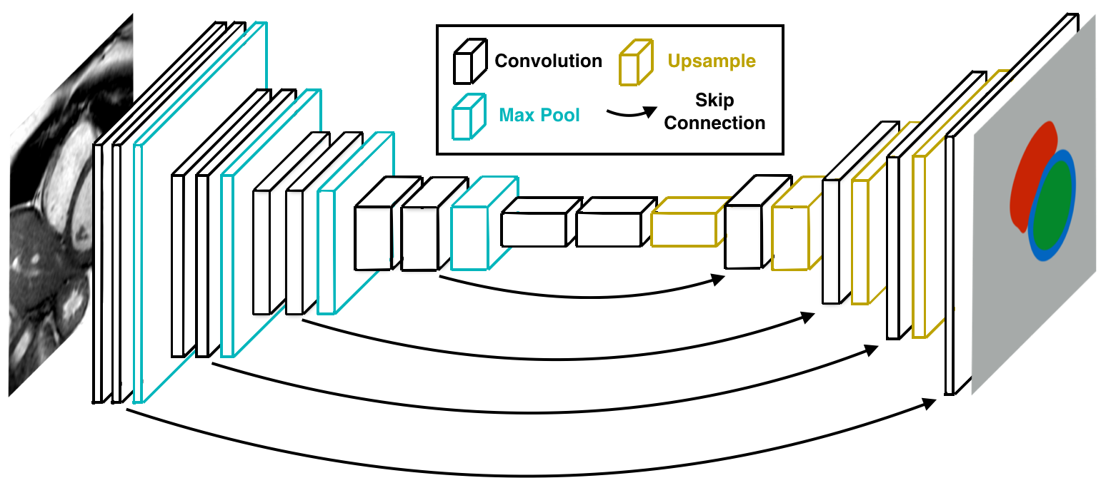
Pixel-wise Predictions for Segmentation
Regenerates an output the same size as the input.
Skip connections are vital in maintaining spatial coherency.
Often called a U-net architecture.

Slide 18
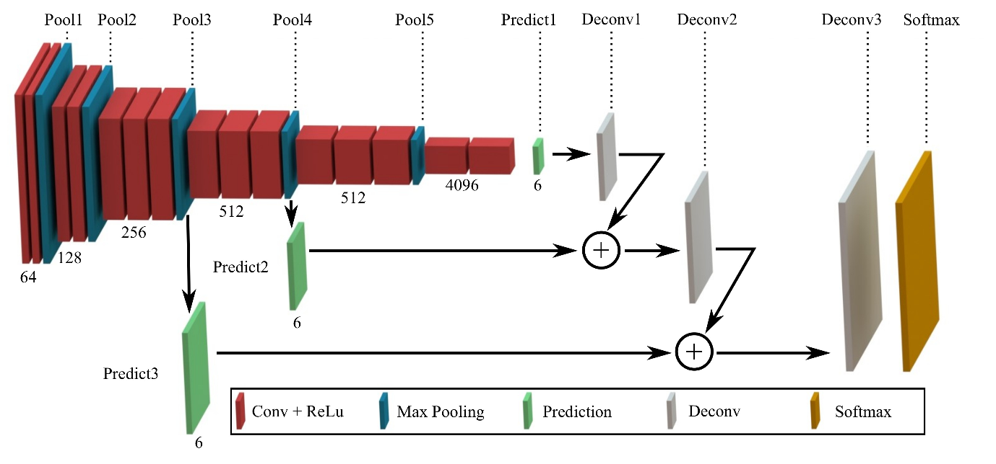
Pixel-wise Predictions for Segmentation

Slide 19
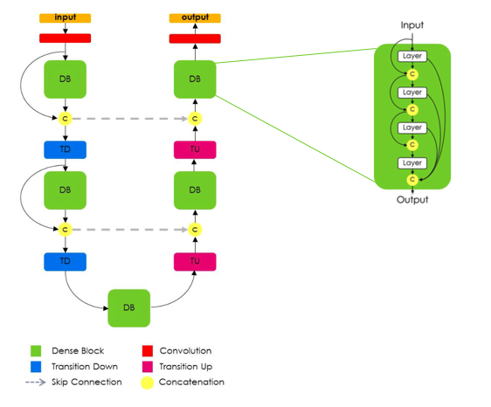
FC Densenet
The input to a layer is a concatenation of the outputs of all layers before it within a block.
Allows each layer to “see” low and high level features at the same time.

Slide 20
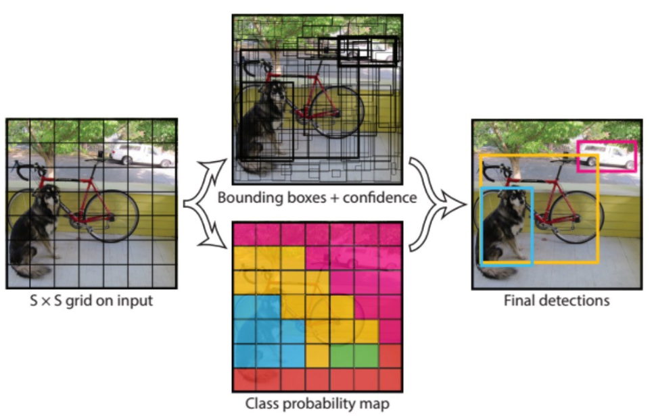
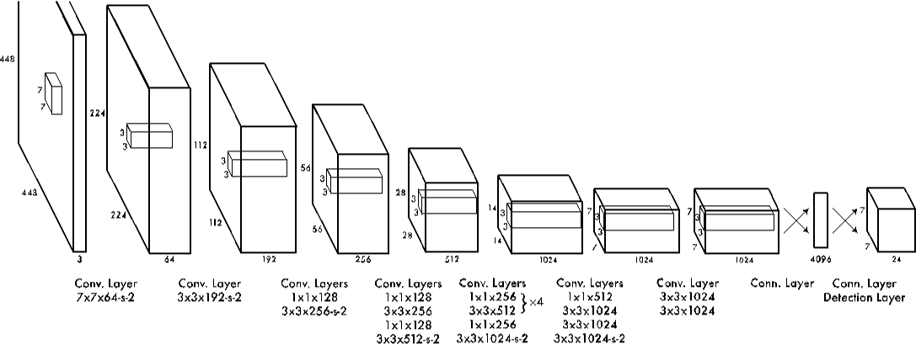
Bounding Box Predictions
Conv-net that predicts the location and size of boxes enveloping an object.
Can represent an entire object with just 5 values: x, y, h, w, class.

